Slide 1
Attendance Code:

Slide 2
OOP – Week 8
Dr. Jizheng Wan
Nov 2023

Slide 3
Structure
Exceptions – Lecture 1
Exception handling – Lecture 1
  try…catch block
Throw and catch multiple exceptions – Lecture 1
Using the finally block – Lecture 1
Checked and unchecked exceptions – Lecture 1
Creating your own Exceptions – Lecture 1
Assertions – Lecture 1

Slide 4
Exceptions
Exception
  The term exception is used in programming language to represent “exceptional” program behaviour, as opposed to the “normal” behaviour.
  If an exception occurs during a program’s execution, it is called runtime exception.
    Runtime exception != syntax error
Exception handling
  Object-oriented techniques that manage or resolve exceptions.

Slide 5
Exceptions
Exceptions can happen due to:
The environment (your PC or at JVM level)
  Disk is out of space.
  File doesn’t exist.
Bad inputs
  Data turns out to be empty.
  Zero or negative values appear where only positive values make sense.
Programming errors
  Array index “out of bounds” (beyond the size of the array).
  Object turns out to be “null”.
  Dividing by zero.
Security attacks

Slide 6
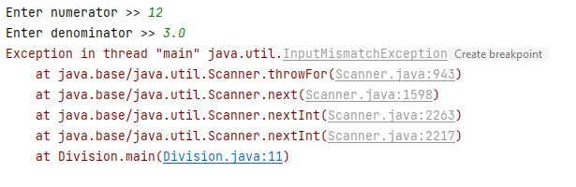
Exceptions
When an exception arises, it does not make sense to continue the execution of the program normally.
  It would only give rise to more exceptions arising.
  It may not even make sense to continue.
  It might be “wrong” to continue (can’t ship the dress if the payment doesn’t go through).
Hence:
  The exception must be detected.
  If possible, the program must recover from the error (set the state back to a reasonable one).
  Some information should be provided to the user that something has gone wrong.
Stack trace

Slide 7
Activity: Knowledge Check
___________ represents the degree to which a system is resilient to stress and able to continue functioning.
a. Sturdiness
b. Robustness
c. Tolerance
d. Vigorousness

Slide 8
Activity: Knowledge Check
___________ represents the degree to which a system is resilient to stress and able to continue functioning.
Answer: b. Robustness
Programs that can handle exceptions appropriately are said to be more fault tolerant and robust. Fault-tolerant applications are designed so that they continue to operate, possibly at a reduced level, when some part of the system fails. Robustness represents the degree to which a system is resilient to stress and able to continue functioning.

Slide 9
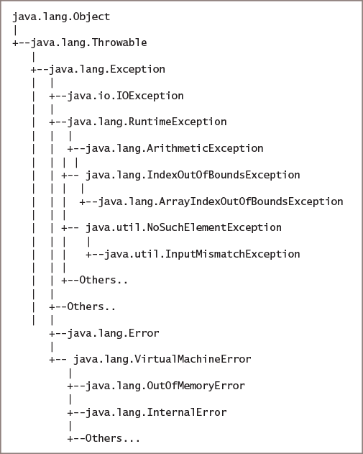
Exceptions
Two basic classes:
  java.lang.Exception
    Represents less serios errors and normally can be recovered.
    E.g. out of bounds exceptions.
  java.lang.Error
    Represents more serious errors which your program (on its own) usually cannot recover.
    E.g. out of memory error.

Slide 10
Exception Handling
try block/clause
A block of code you attempt to execute knowing an exception might occur.
Consist of:
  The keyword try followed by a pair of curly braces {}.
  Executable statements between the braces.
catch block/clause
The keyword catch followed by a pair of parentheses ().
Between the parentheses, an Exception type and an identifier for an instance.
A pair of curly braces that contain statements that take actions to handle the error condition.

Slide 11
Exception Handling
catch block/clause
Programmed immediately after a try block.
Each catch block can catch one type of exception. (e.g. ArithmeticException,…)
try {
result = numerator / denominator;
System.out.println(numerator + " / " + denominator + " = " + result);
}
catch (ArithmeticException ae) {
System.out.println("Arithmetic exception was thrown an exception.");
}

Slide 12
Exception Handling
Things to remember:
Variables declared within the block go out of scope when the block ends.
To use variables with both a try or catch block and afterwards:
  Declare and assign values before the block begins.
With multiple statements in the try block:
  Only the first error-generating statement throws an exception.
  Once an exception occurs, the rest of the statements (in the try block) will be skipped.
Exception.getMessage() provides more information about the exception.
Code: Main2.java

Slide 13
Throw and catch multiple exceptions
With multiple catch blocks:
Examined in sequence until a match is found.
The matching catch block executes.
Code: Main3.java

Slide 14
Using the finally Block (optional)
The finally clause is meant for clean-up of resources (which need to be done for both normal and exceptional runs)
  If you have network connections open, you might need to close them.
  If you have files open, you might need to close them.
  You might need to reset the state of objects to some clean state, where they can continue working normally.
Code executes whether or not the preceding try block identifies an Exception.

Slide 15
Activity: Knowledge Check
Which of the following statements is true?
A try block can have many catch blocks but only one finally block.
A try block can have many catch blocks and many finally blocks.
A try block must have one finally block for each catch block.
A try block must have at least one catch block to have a finally block.
Answer: a

Slide 16
Activity: Knowledge Check
Code 1
Code 2
public class Test {
public static void main(String[] args) {
try {
return;
}
catch (Exception ex){}
System.out.println("Finally");
}
}
public class Test {
public static void main(String[] args) {
try {
return;
}
finally {
System.out.println("Finally");
}
}
}
What are the outputs from Code 1 and Code 2?
Code 1 = Code 2 = “Finally”.
Code 1 = “”, Code 2 = “Finally”.
Code 1 = Code 2 = “”.
Code 1 = “Finally”, Code 2 = “”.
Answer: b

Slide 17
Summary
Java treats all errors/exceptional behaviours as “exceptions”.
There is a class called Exception, and further subclasses of it.
When an exceptional situation is detected,
  Java halts the normal execution, and
  Creates and “throws” an exception object.
Your Java program can “catch” the exception object and handle the situation (“exception handler”).
  It may attempt to recover from the exceptional situation.
  Or, it may throw an exception in turn.
If the exception is not “caught”, then the program execution stops and prints an error message.

Slide 18
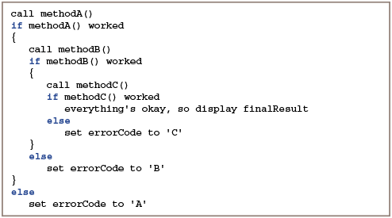
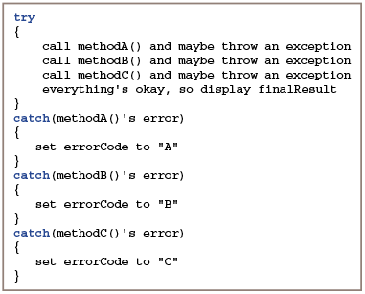
Summary
non-object-oriented
object-oriented

Slide 19
Summary
object-oriented
Object-oriented exception handling advantages:
Clarity
Flexible
  In most object-oriented programs that same method that throws an exception doesn’t catch it
Can be reused

Slide 20
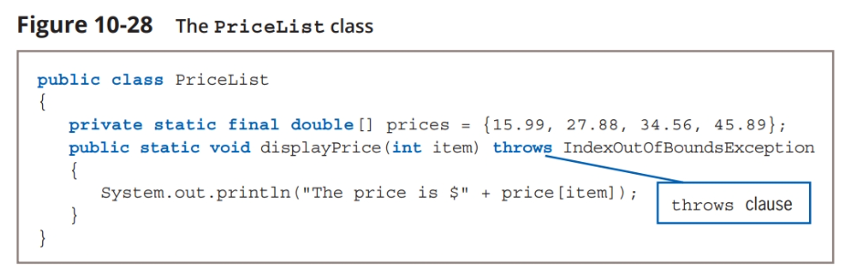
Use the throws keyword
If a method throws an exception that it will not catch but that a different method will catch, you must create a throws clause by using the keyword throws followed by an Exception type in the method header

Slide 21
Checked exceptions
Generally a method must declare all the exceptions it can potentially throw:
  public TYPE methodC(TYPE argument) throws XException, YException, …;
Any method that calls methodC is required to either
  Catch the declared exceptions, or
  Declare that it throws them
All exceptions that work in this way are called “Checked exceptions”.
Note: if methodB calls methodC, and methodC throws XException, then an exception has arisen in the middle of methodB. (From Java’s point of view, methodB has “thrown” XException).

Slide 22
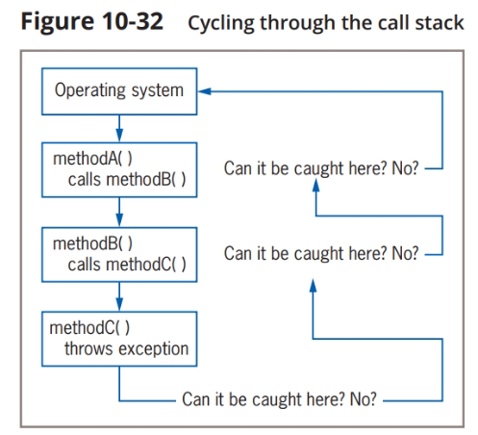
How check exceptions work

Slide 23
Unchecked exceptions
Fortunately, Java allows a limited number of basic exceptions to be thrown without the catch-or-declare requirement.
These are called “unchecked exceptions”.
Java does not verify unchecked exceptions at compile-time.
These exceptions inherit from the Error class or the RuntimeException class.
public static void displayPrice(int item) throws IndexOutOfBoundsException{
System.out.println("The price is $" + prices[item]);
}

Slide 24
Create your own Exception classes
Creating a throwable Extension class:
  Extend the Exception subclass of Throwable
  Exception class constructors
  Exception(): new object with null detail message
  Exception(String message): new object with specified message
  Exception(String message, Throwable cause): new object with specified message and cause
  Exception (Throwable cause): new objects with specified cause and detail message of cause.toString()

Slide 25
Assertions in Java
“Assertion” is a term used to describe properties that program variables are expected to satisfy at particular points in the program.
Java provides an assertion facility to document such properties, which is helpful for debugging.
You can add assertions for:
  Pre-conditions of methods: properties the inputs are expected to satisfy, and
  Post-conditions of methods: properties the outputs are expected to establish.
Write
  assert BOOLEAN-EXPRESSION : statement;
If the assertion is not true, Java gives an AssertionError (a subclass of Error).

Slide 26
Exceptions
Exception
  The term exception is used in programming language to represent “exceptional” program behaviour, as opposed to the “normal” behaviour.
  If an exception occurs during a program’s execution, it is called runtime exception.
    Runtime exception != syntax error
Exception handling
  Object-oriented techniques that manage or resolve exceptions.

Slide 27
Activity: Knowledge Check
Which of the following statement is wrong?
a. An advantage to using object-oriented error-handling techniques is that programs are clearer and more flexible.
b. An advantage to using object-oriented error-handling techniques is that when a method throws an exception, it will always be handled in the same, consistent way.
c. In many cases, you want a method to check for errors, but you do not want to require the method to handle an error if it finds one.
Answer: b

Slide 28
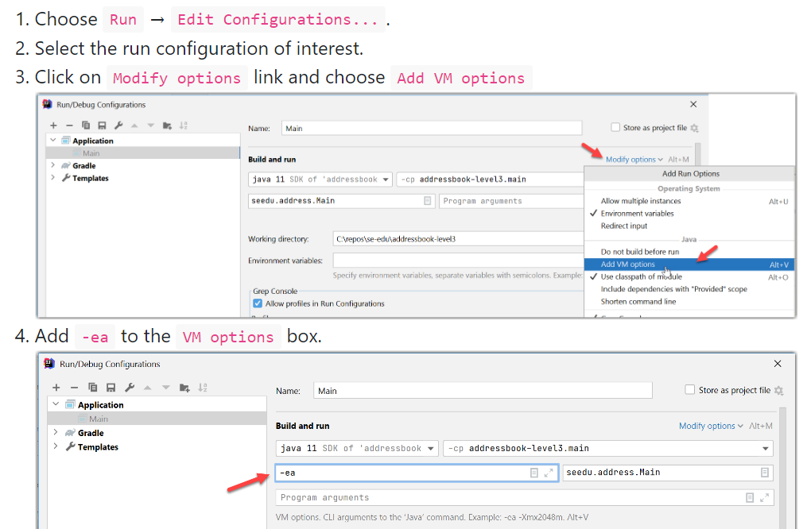
Enabling assertions in IntelliJ

Slide 29

Q & A

